Slide 1
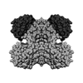
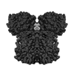
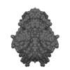
Heterogeneity in Tomography
The first two structures are two conformations of holo-glyceraldehyde-3-phosphate dehydrogenase from Bacillus stearothermophilus.
Both views are taken from front C2-axis.
The third structure is from a different molecule - Reduced form of OxyR from Neisseria meningitidis.

Slide 2
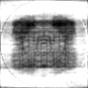
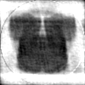
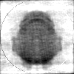
Reconstruction Results
No. of projections – 30000
Noise – 25%
Image size – 100*100
24.35%
25.38%
19.19%

Slide 3
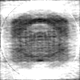
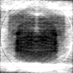
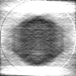
Reconstruction Results
No. of projections – 30000
Noise – 50%
Image size – 100*100
36.94%
38.35%
43.12%

Slide 4


Another example – 2 Classes

Slide 5
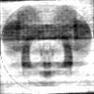
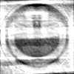
Reconstruction Results
No. of projections – 40000
Noise – 25%
Image size – 100*100
31.62%
29.18%

